Slide 1

Participant Details
Participant Name:
Problem Statement:

Slide 2
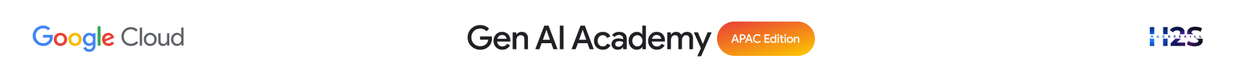
Brief about the idea
Type here…

Slide 3
Your solution should be able to explain the following:
How did you approach the common problem statement and translate it into a working solution using ADK, MCP/AlloyDB AI while ensuring Hackathon’s core requirements are met?
What real-world problem does your solution address, and what practical impact does it create for users?
What is the core approach or workflow behind your solution?
Type here…

Slide 4
Opportunities
How different is it from any of the other existing ideas?
USP of the proposed solution
Type here…

Slide 5
List of features offered by the solution
Type here…

Slide 6
Process flow diagram or Use-case diagram
Type here…

Slide 7
Wireframes/Mock diagrams of the proposed solution
Type here…

Slide 8
Architecture diagram of the proposed solution:
Type here…

Slide 9
Technologies/Google Services used in the solution (Why did you choose your specific AI stack and system design, and how does it support scalability and real-world deployment?)
Type here…

Slide 10
Snapshots of the prototype
Type here…

Slide 11


